Slide 1
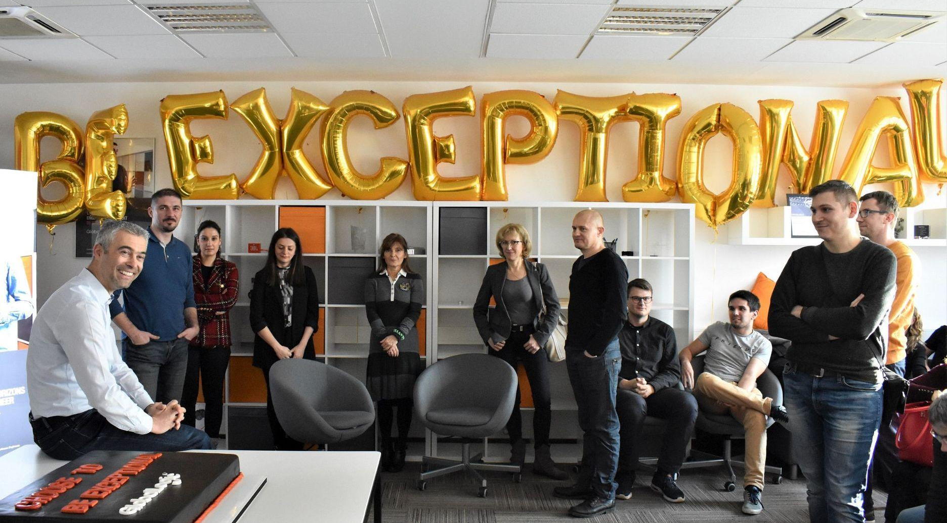
In GlobalLogic We Care about people
Join us in Croatia to see it for yourself!

Slide 2
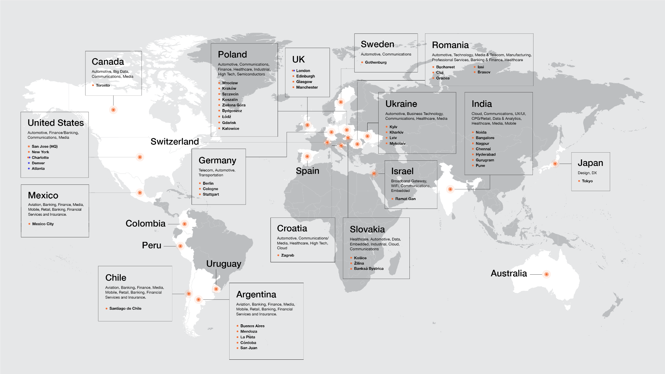
GlobalLogic is a place for innovators, visioners and out-of-the-box thinkers
2000
29,000+
1,800+
500+
70+
45
9
8
Founded
Engineers in 20+ countries
Product releases per year
Active clients
Private label customer labs
Product engineering centers
Sales offices (HQ in Silicon Valley)
Design studios

Slide 3
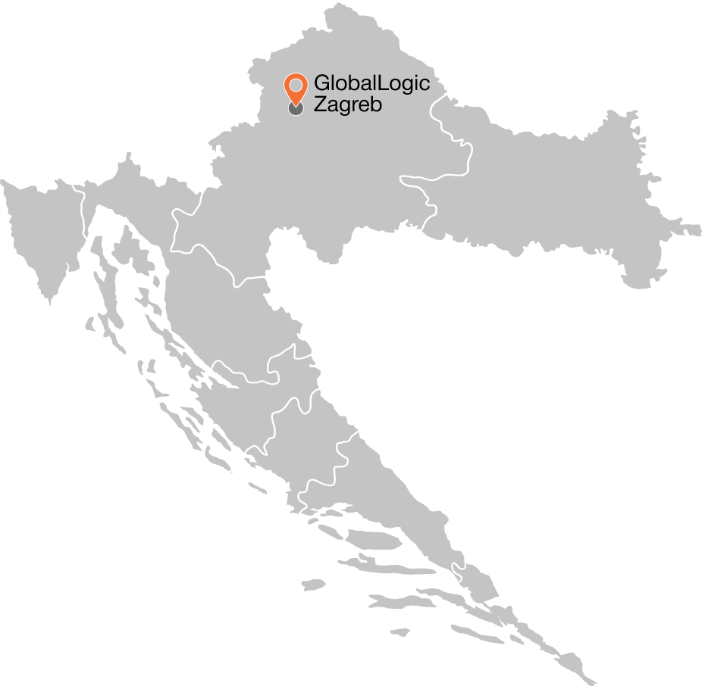
​​GlobalLogic in Croatia: Key Facts
160+
Professionals
38
Projects
19
Сlients

Slide 4
GlobalLogic helps our specialists develop and be truly happy!
Support in the relocation process
Comfortable offices and relaxation zones
Openness and friendly atmosphere
International projects
Possibility to work from home or from office according to your preferences
Innovative and development projects
Work-life balance and flexible working hours

Slide 5
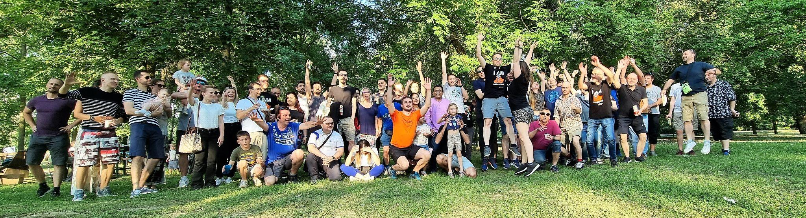
Health services and Wellbeing support
Free Annual examination
Insurance covered during business trips
Multisport Cards
Co-financing for meals
Rent subsidies
In a private polyclinic
For subtenancy

Slide 6
Learning and Development
Internal
Learning Courses
Knowledge sharing
Via Meetups and internal communities
Personal education program for Trainees
Mentorship
program
Support for learning on external platforms and obtaining certifications, e.g. Udemy for Business
Educational
online platform (Percipio,
GlobeSmart)
Participation
and organization of technological training events
Various
language courses
Internal
trainers community
Cultural lectures
and initiatives
Internal education programs: Tech skills, Leadership skills, Communication skills

Slide 7
Professional growth and development
Professional Growth
Individual Development Plan
Annual performance review
Regular
feedback sessions
Relocation opportunities within the company
Opportunity
to rotate to a different project
Regular 1x1
meetings with an HR Business Partner

Slide 8
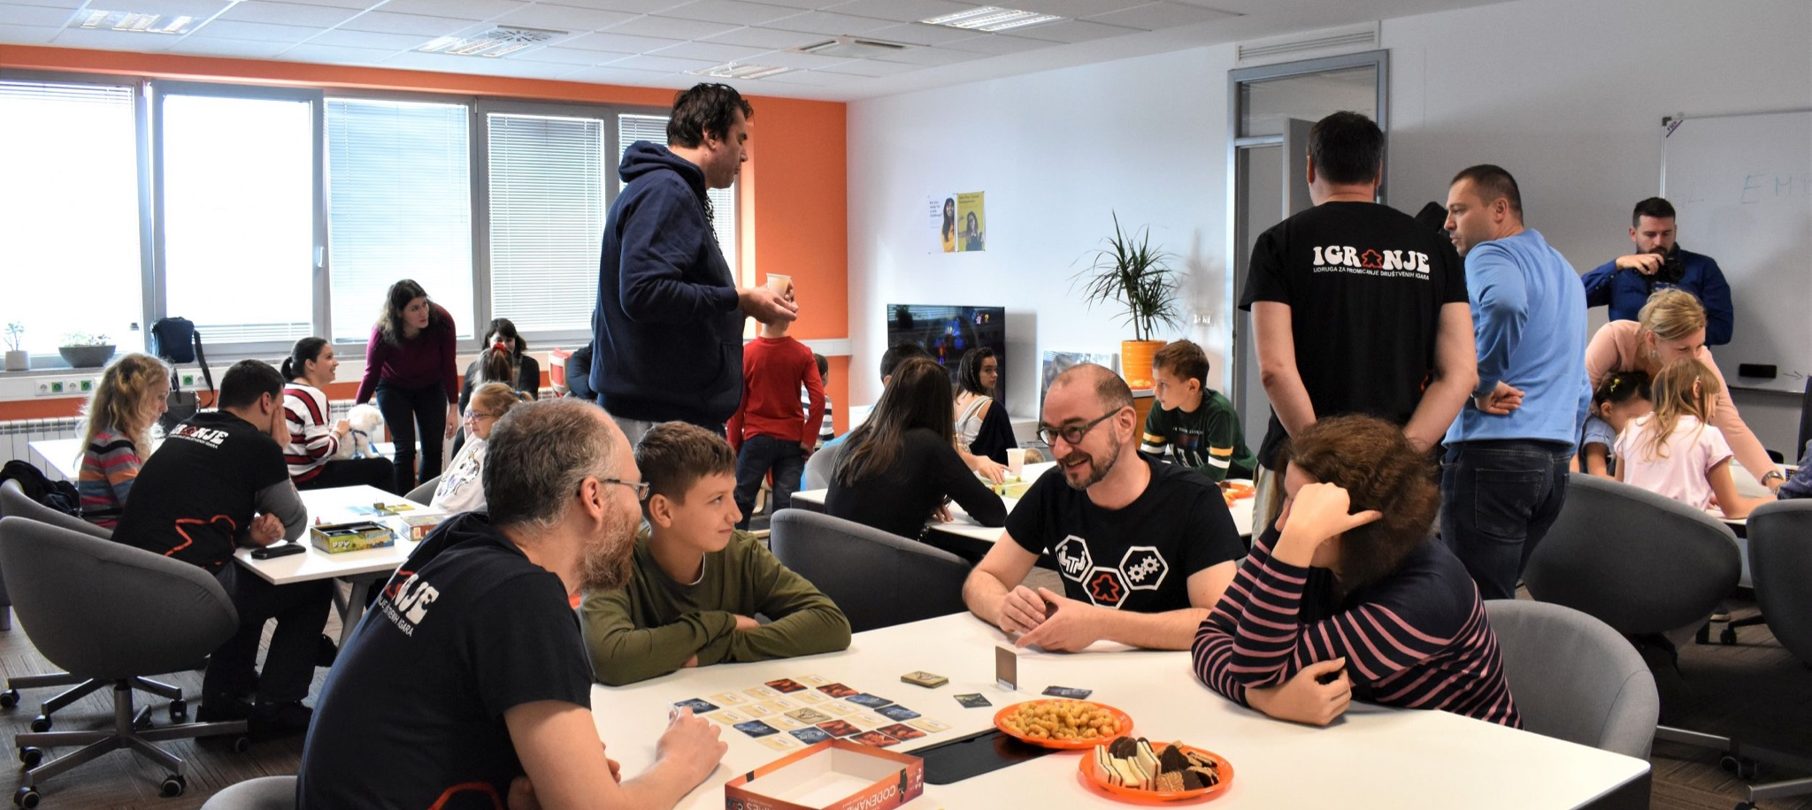
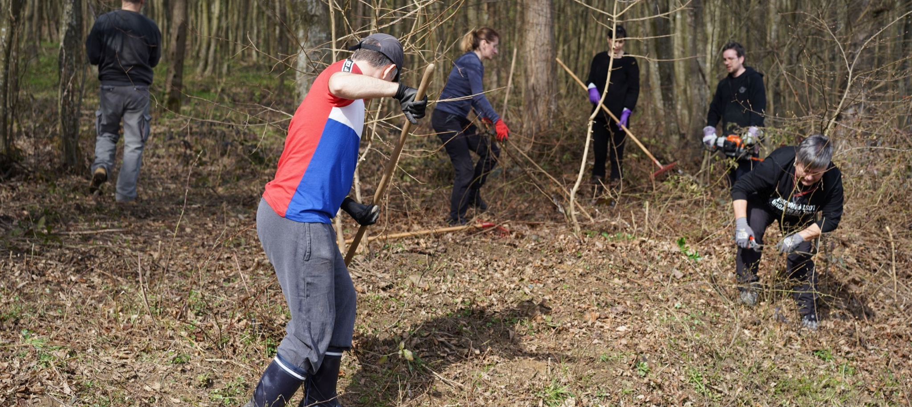
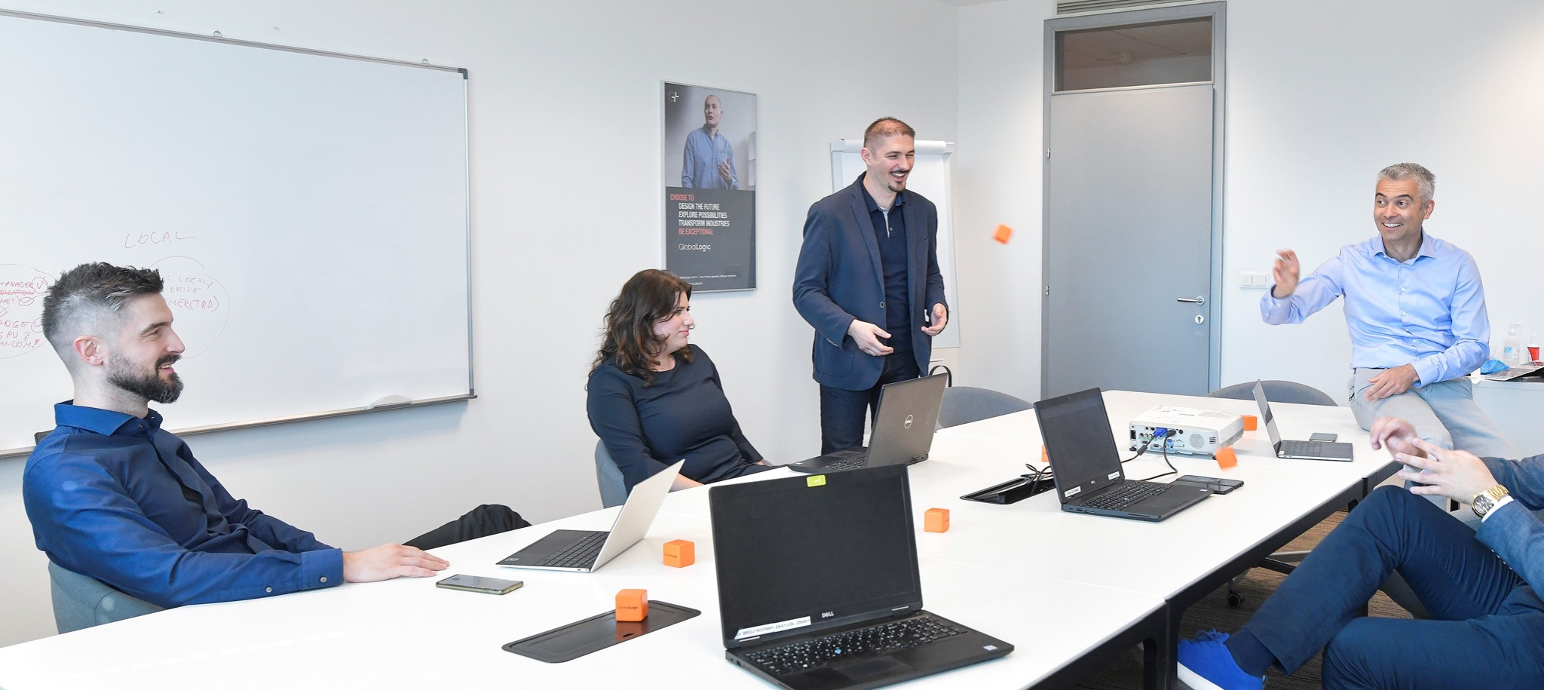
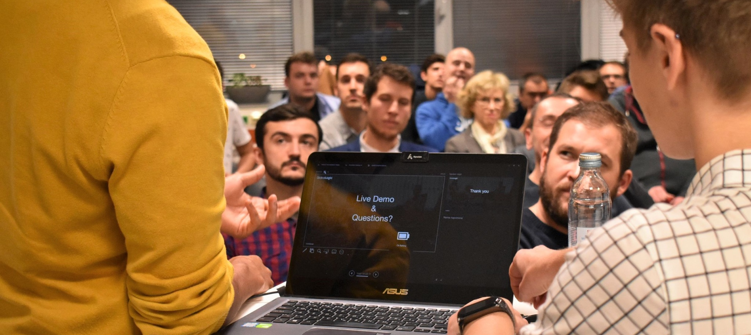
And even more benefits here:
Corporate and office parties (e.g. Carnival Party, Summer Party, Children Day)
Fresh fruits in our office
Paid annual leave of at least 20 working days and at most 28 working days
Increased tax deductible costs for author's work under an employment contract
Secured bike parking
Discounts in selected shops/services
Christmas bonus, holiday pay and childcare allowance and an annual child award
Project bonuses for top performer, Referral and Mentoring

Slide 9
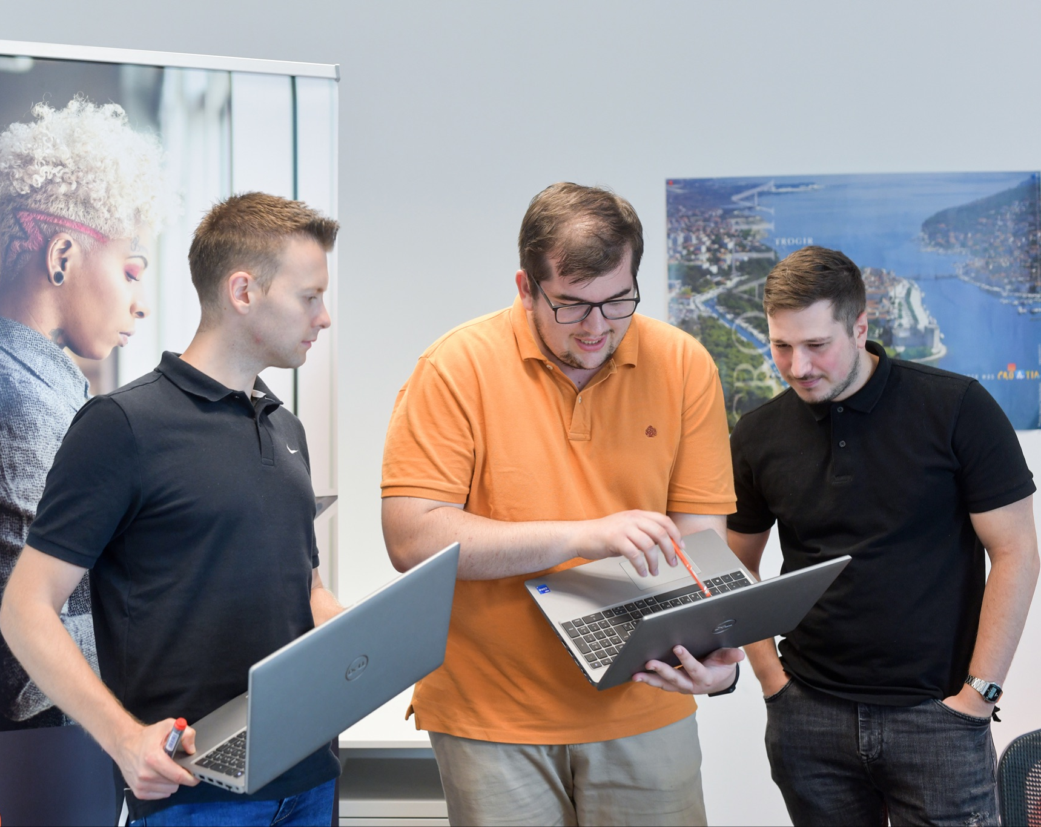
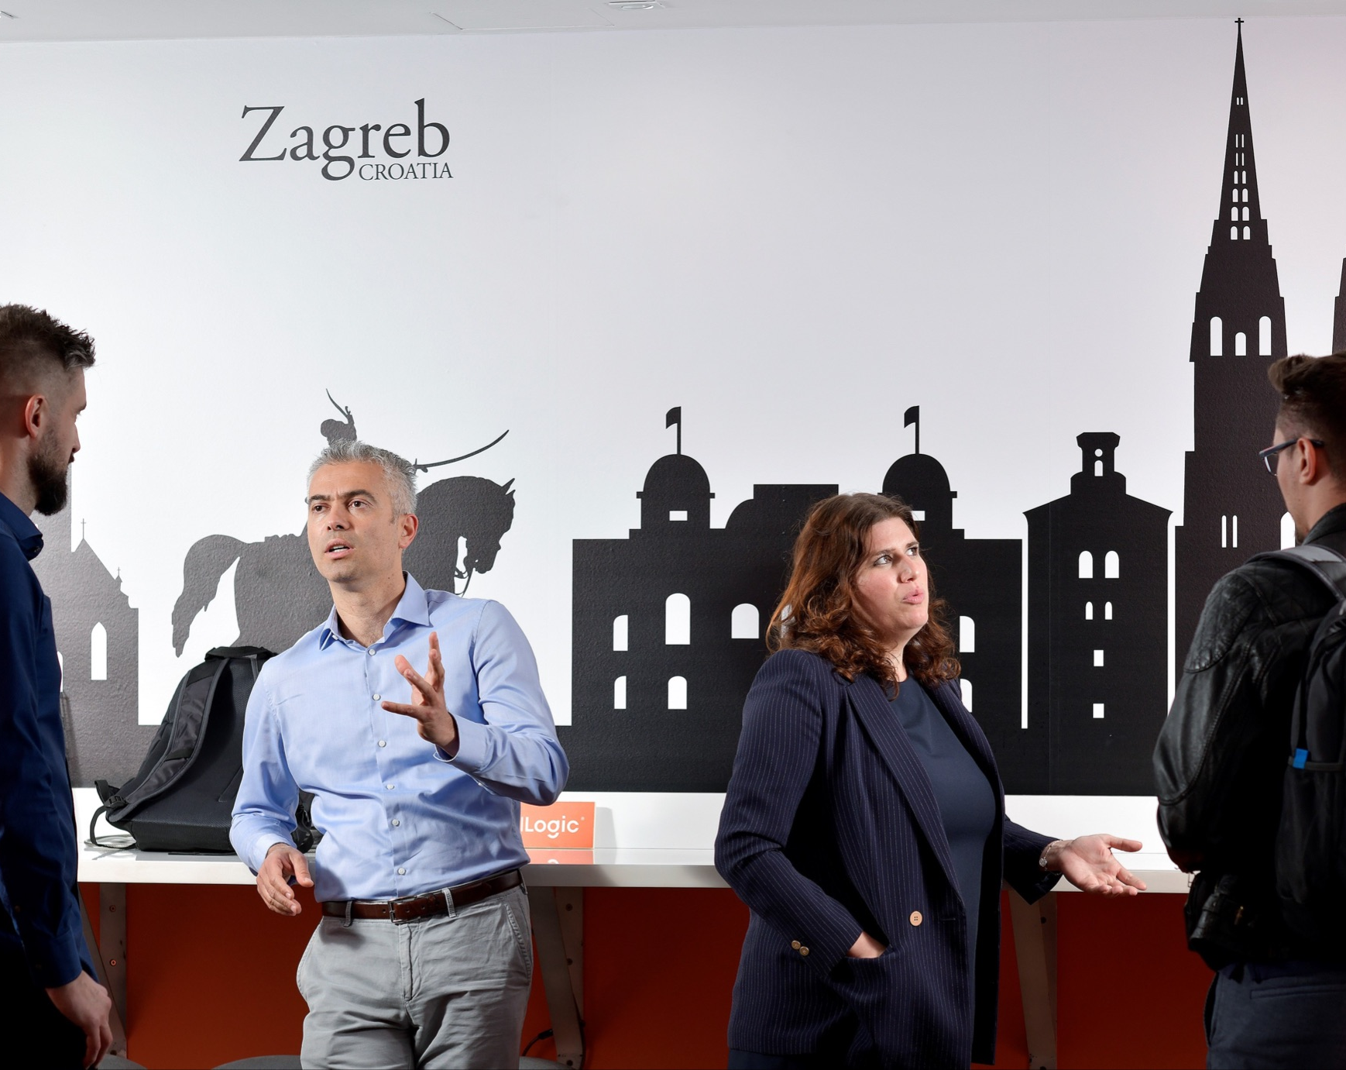
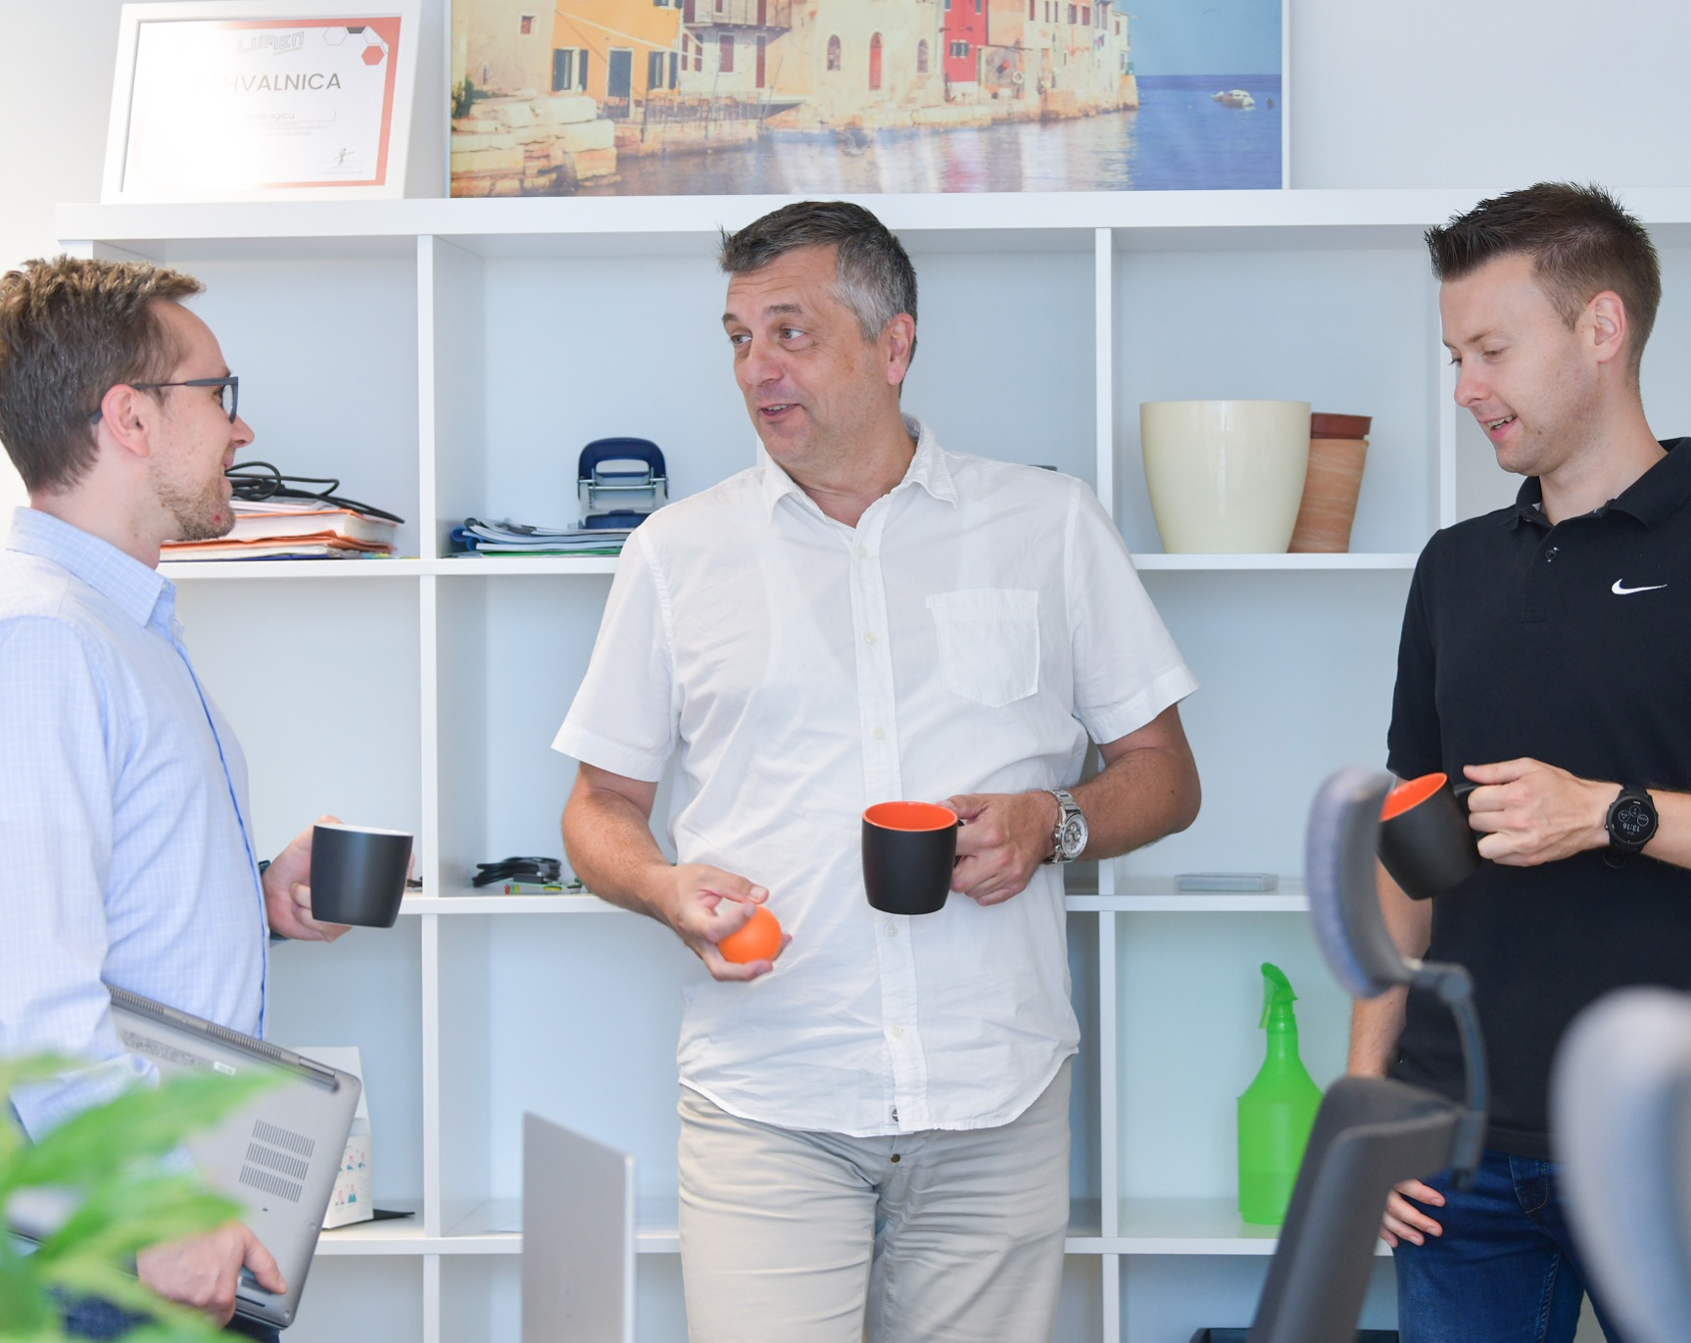
Our great offices and comfortable remote/hybrid formats of cooperation are waiting for you!
Our Office address
Zagreb
Ulica Grada Vukovara 284, 10000
Show on map

Slide 10
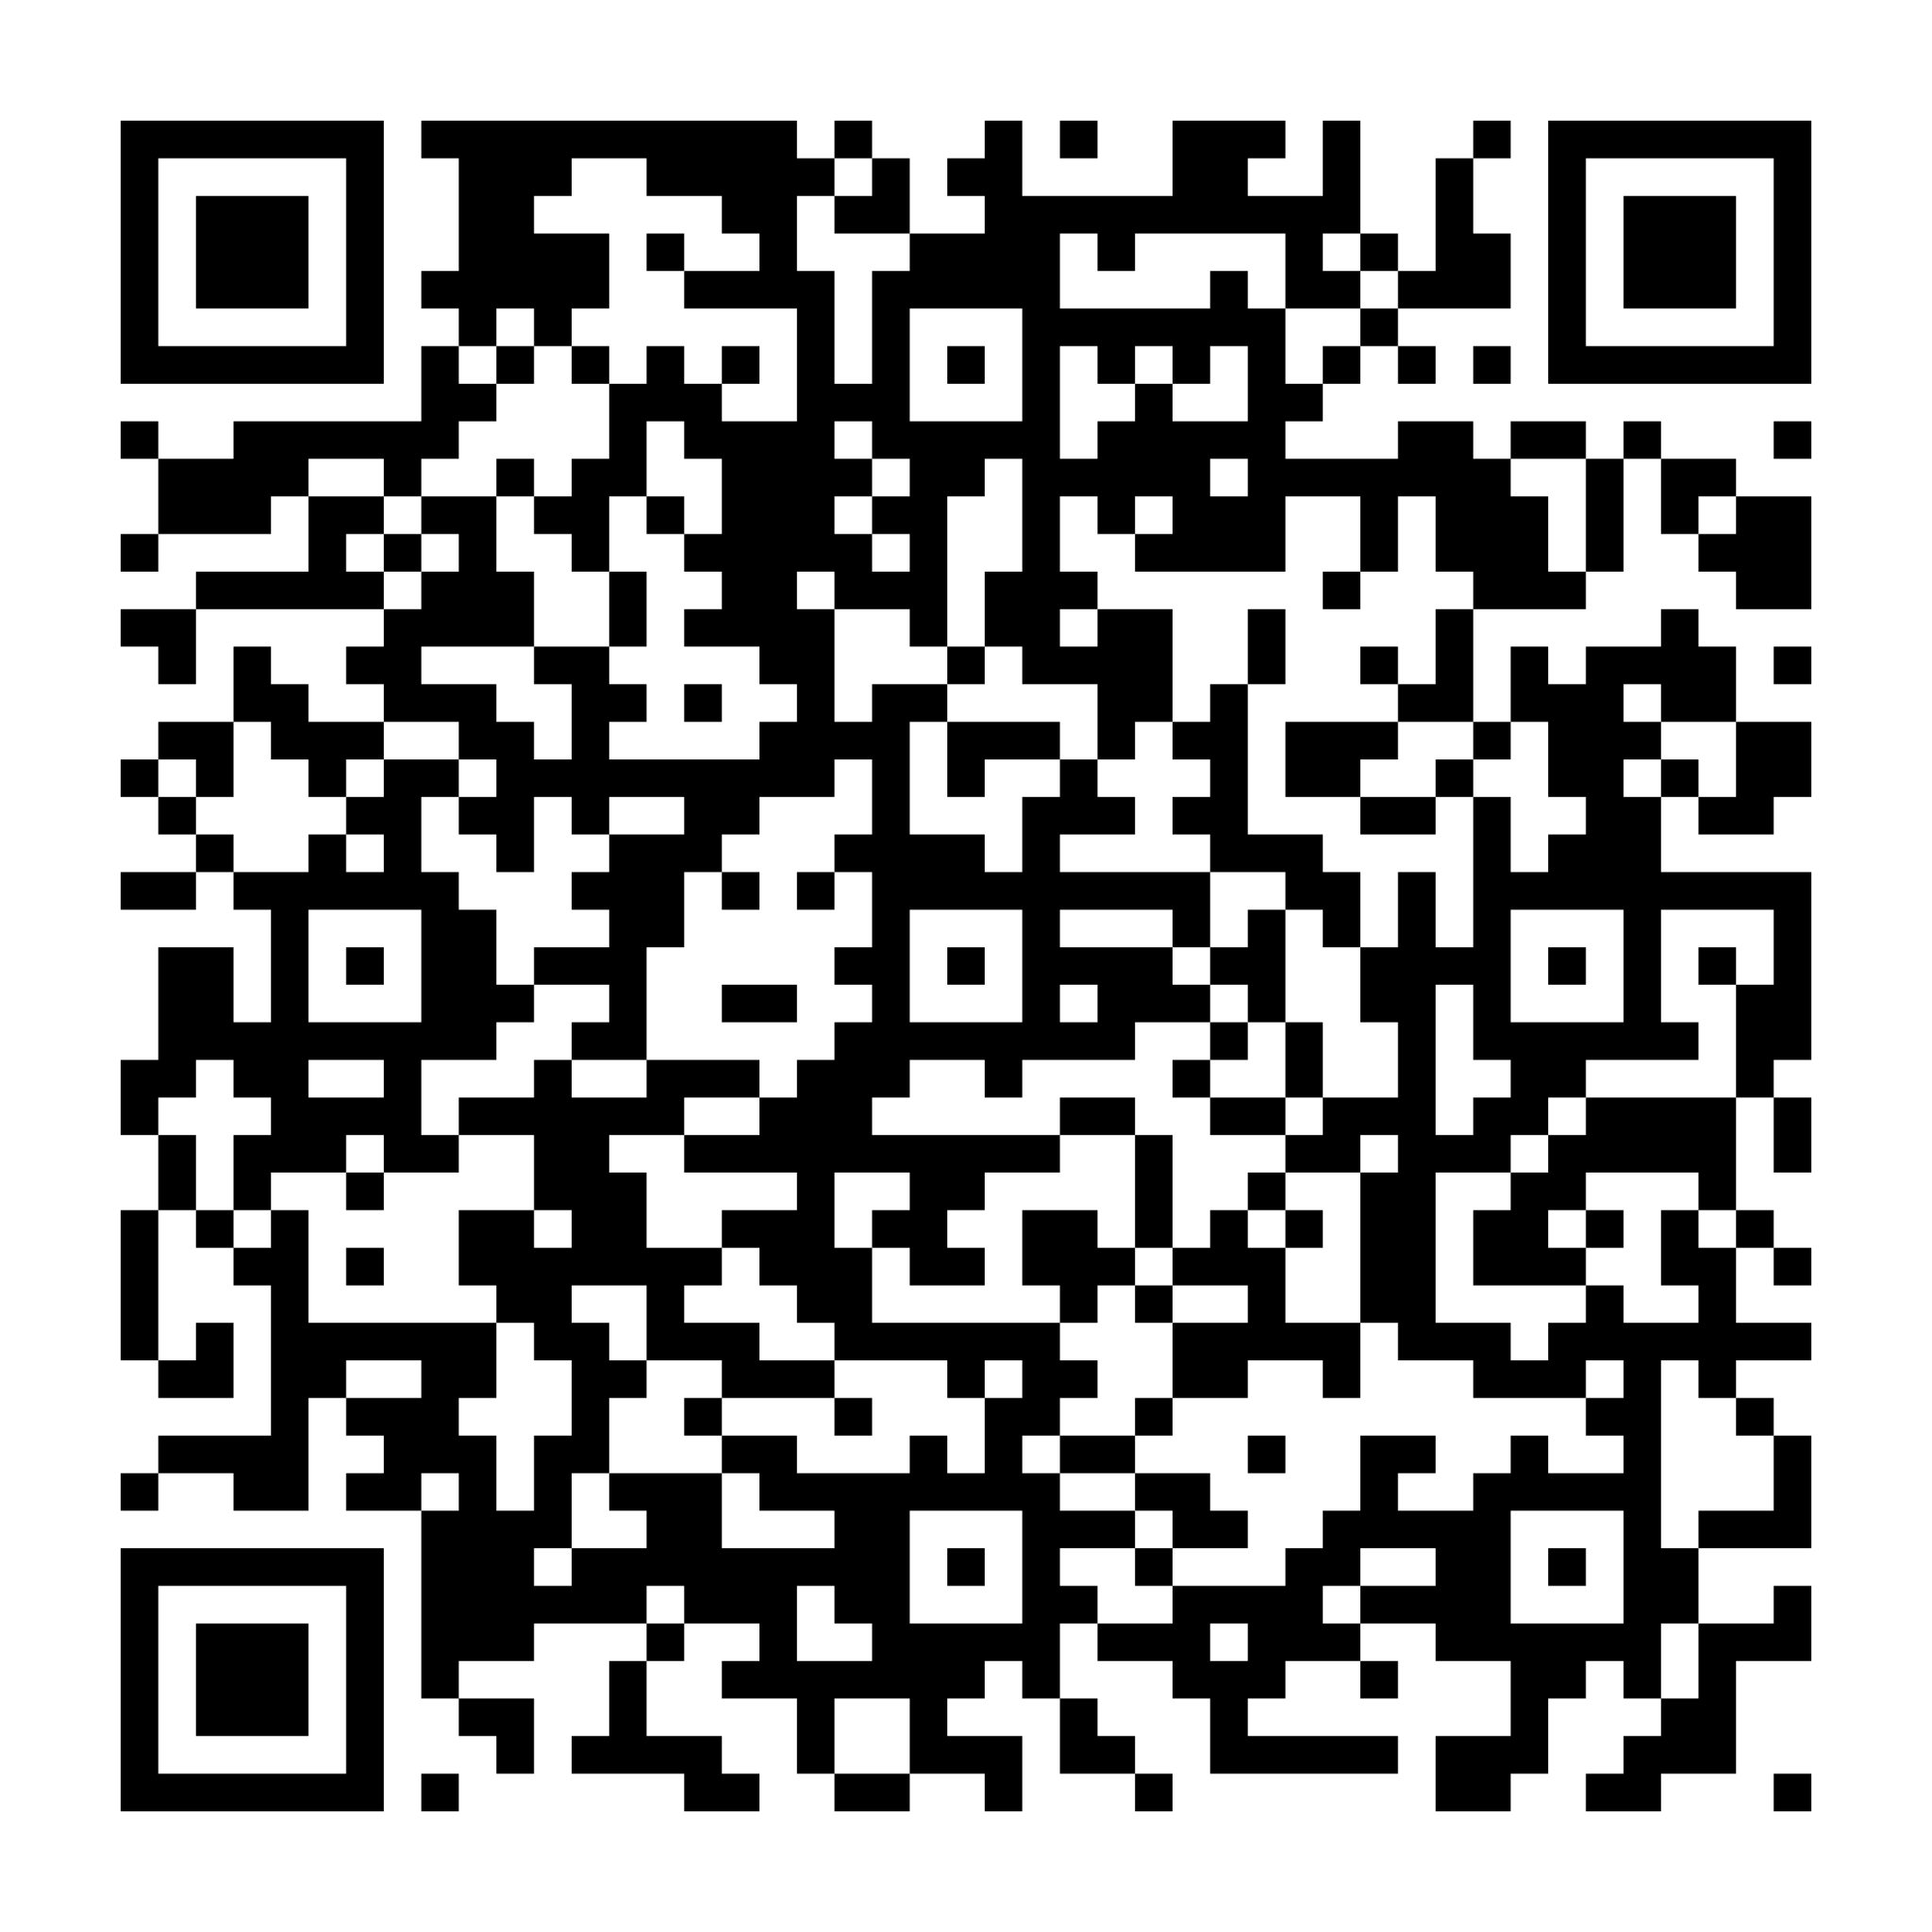
Let's get connected!
We will help you build
an exceptional career.
globallogic.com/hr/
facebook.com/GlobalLogicCroatia/
linkedin.com/company/globallogic-croatia/
Youtube.com: GlobalLogic Croatia
Click here and join us!

